Slide 1

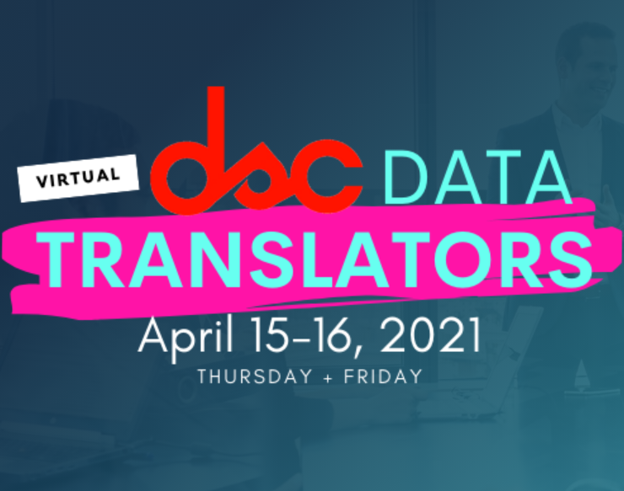
Machine Learning with PyCaret
Apr 15, 2021

Slide 2





About me
Data Scientist with 10+ years of experience in solving business problems using data.
Background in Finance, Economics, Analytics, and Data Science.
Worked in Healthcare, Education, Consulting, and Fintech.
Member of CPA, CMA, Canada and ACMA, UK, CGMA
Lived and worked in Asia, Middle East, East Africa, North America. Currently based in Toronto, Canada
https://www.linkedin.com/in/profile-moez/
https://moez-62905.medium.com/
https://twitter.com/moezpycaretorg1
moez@pycaret.org

Slide 3
Important Links
Official : https://www.pycaret.org
Docs: https://pycaret.readthedocs.io/en/latest/
PyCaret GitHub : https://www.github.com/pycaret/pycaret
LinkedIn : https://www.linkedin.com/company/pycaret
YouTube : https://www.youtube.com/channel/UCxA1YTYJ9BEeo50lxyI_B3g
Medium : https://moez-62905.medium.com/
Today’s Presentation and Demo : https://www.github.com/pycaret/pycaret-demo-dsc
Follow hashtag #pycaret on LinkedIn and Twitter

Slide 4

Join our community!
https://join.slack.com/t/pycaret/shared_invite/zt-nm02k73a-PSDo5lwmQ6evlFCPRxsKKA

Slide 5
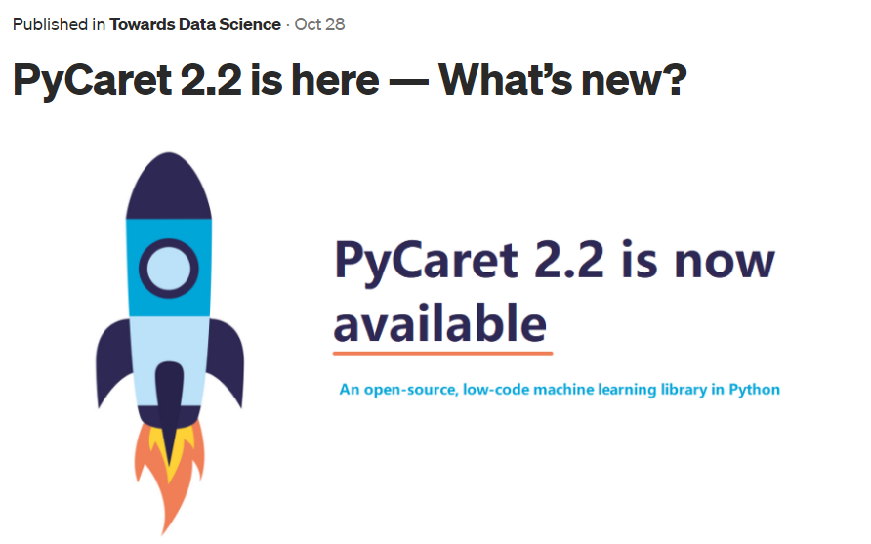
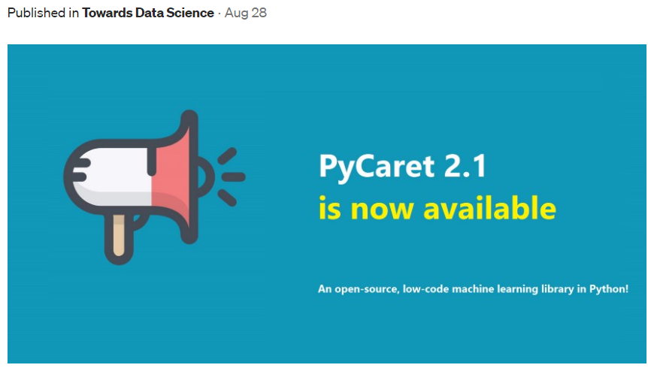
Resources
https://towardsdatascience.com/pycaret-2-2-is-here-whats-new-ad7612ca63b
https://towardsdatascience.com/pycaret-2-1-is-here-whats-new-4aae6a7f636a

Slide 6
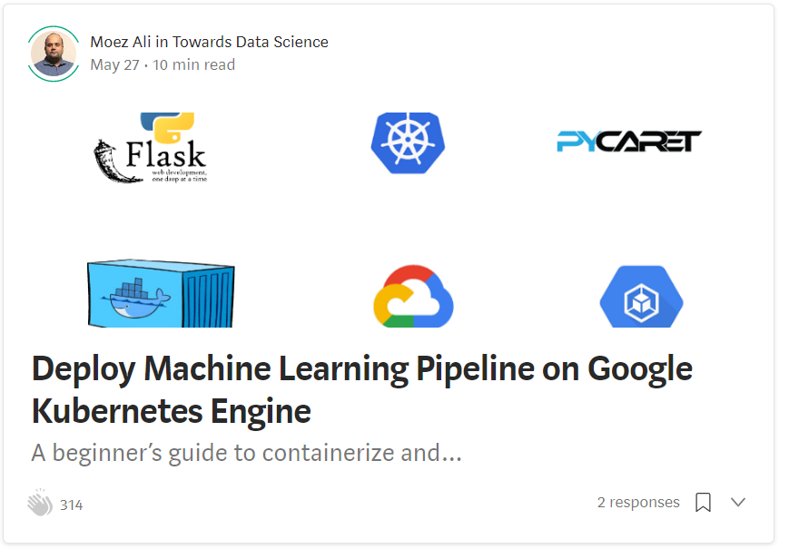
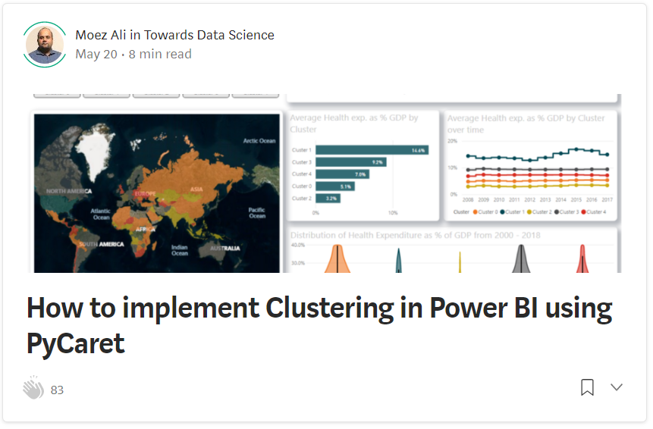
Resources (cont.)
https://towardsdatascience.com/deploy-machine-learning-model-on-google-kubernetes-engine-94daac85108b
https://towardsdatascience.com/how-to-implement-clustering-in-power-bi-using-pycaret-4b5e34b1405b

Slide 7
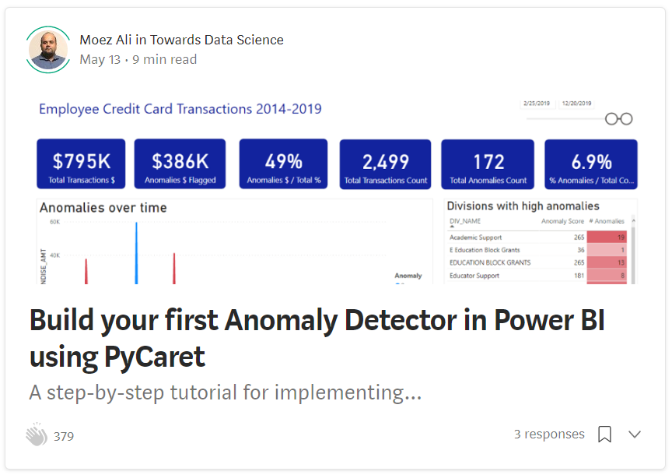
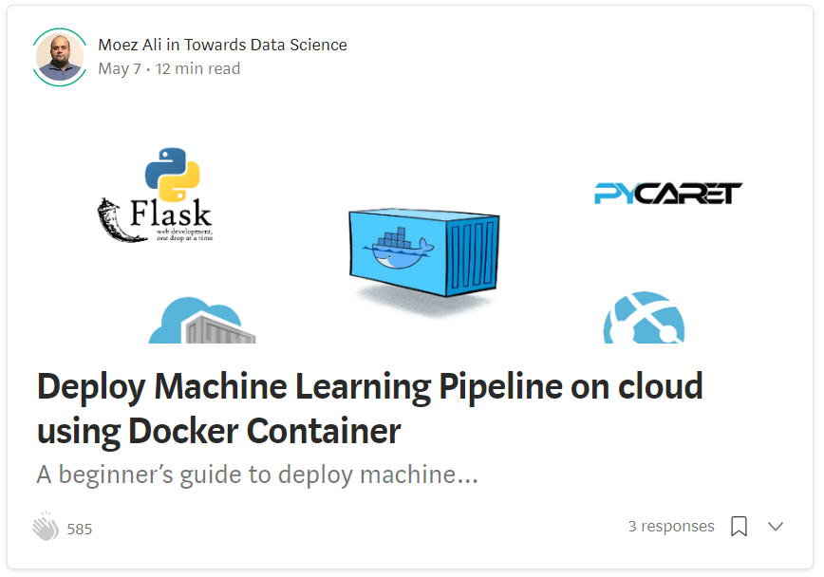
Resources (cont.)
https://towardsdatascience.com/build-your-first-anomaly-detector-in-power-bi-using-pycaret-2b41b363244e
https://towardsdatascience.com/deploy-machine-learning-pipeline-on-cloud-using-docker-container-bec64458dc01

Slide 8
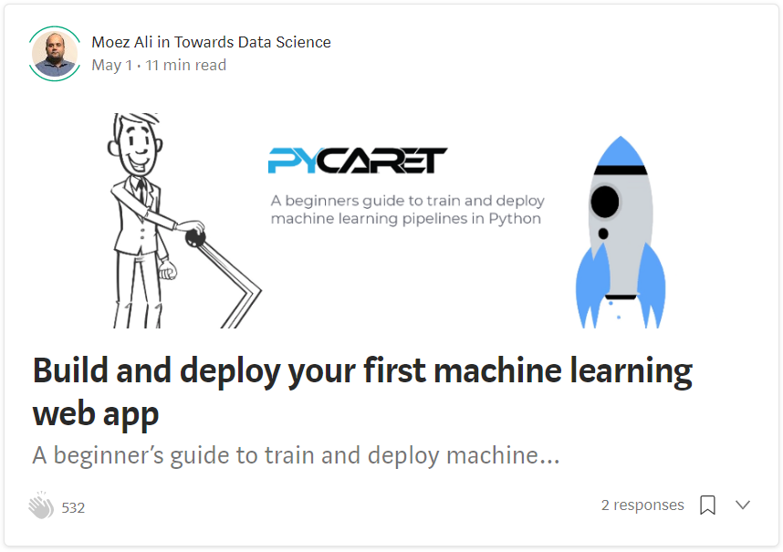
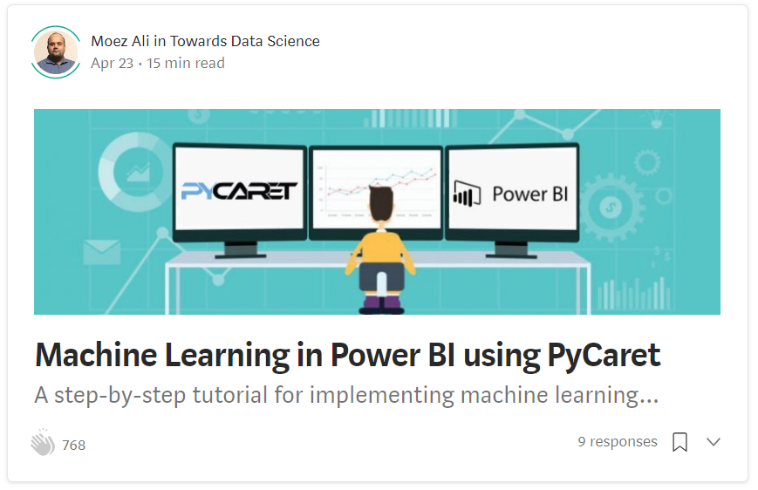
Resources (cont.)
https://towardsdatascience.com/build-and-deploy-your-first-machine-learning-web-app-e020db344a99
https://towardsdatascience.com/machine-learning-in-power-bi-using-pycaret-34307f09394a

Slide 9
Resources (cont.) – Official Video Tutorials
Binary Classification Video Tutorial
https://www.youtube.com/watch?v=2xAgLKUN6Xs
Clustering in PyCaret Video Tutorial
https://www.youtube.com/watch?v=2oxLDir7foQ
Anomaly Detection in PyCaret Video Tutorial
https://www.youtube.com/watch?v=q0dxYDq1A40&t=2s
Topic Modeling in PyCaret Video Tutorial
https://www.youtube.com/watch?v=G6ShuoM3T1M
Association Rule Mining in PyCaret Video Tutorial
https://www.youtube.com/watch?v=XYAGwts5qGw

Slide 10
Resources (cont.)
Machine Learning in SQL by Umar Farooque
https://towardsdatascience.com/machine-learning-in-sql-using-pycaret-87aff377d90c
PyCaret’s integration with Tableau by Andrew Cowan-Nagora
https://towardsdatascience.com/machine-learning-in-tableau-with-pycaret-166ffac9b22e
NLP Classification using PyCaret by Prateek Baghel
https://towardsdatascience.com/predicting-crashes-in-gold-prices-using-machine-learning-5769f548496
Predict Gold Price Returns using PyCaret by Riazuddin Mohammad
https://towardsdatascience.com/machine-learning-to-predict-gold-price-returns-4bdb0506b132
Predict Crashes in Gold Price using PyCaret by Riazuddin Mohammad
https://towardsdatascience.com/predicting-crashes-in-gold-prices-using-machine-learning-5769f548496

Slide 11
Resources (cont.)
Binary Classification Notebook by Murali Tedla
https://colab.research.google.com/drive/1W6ZYw5oAN7V85utFkXkCQq3iBWjqP1WB
Wine Quality Prediction by Abhinav Arora
https://colab.research.google.com/drive/1uFNmhgM9ghVrtqN3MXaofxDlLePb3yIi#scrollTo=sYsHyY8uH6tb
Build your machine learning models by Lakshay Arora
https://www.analyticsvidhya.com/blog/2020/05/pycaret-machine-learning-model-seconds/
PyCaret’s Integration with Power BI (1 Hour Video Tutorial)
https://www.youtube.com/watch?v=ZeQVkEWo2x0
Anomaly Detection using PyCaret by Krish Naik (Video Tutorial)
https://www.youtube.com/watch?v=ZeQVkEWo2x0

Slide 12
Let’s get started

Slide 13

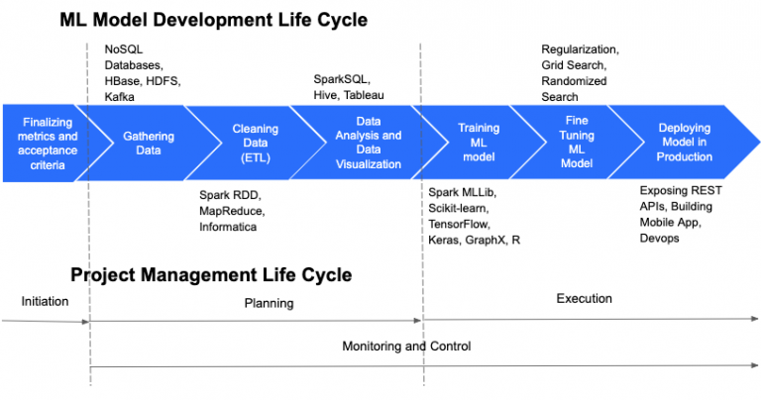
https://cloudxlab.com/blog/things-to-consider-while-managing-machine-learning-projects/machine-learning-and-project-management-life-cycle-2/

Slide 14
Granular ML Life Cycle
Business Problem
Define ML Objective
Collect Data
Analyze
Train Test Split
Handle Datatypes
Impute Missing Values
… zillion other things
Feature Selection
Feature Interaction
Feature Engineering
Transformations
Scaling
Encodings
REPEAT
Model Training
Cross Validation
Track Performance
Hyperparameter tuning
Track Performance
Ensemble Model
Track Performance
Deploy Model
… zillion other things
Analyze Plots
Track Performance
Stack Models
Track Performance
Blend Models

Slide 15



What is PyCaret?
PyCaret is an open source, low-code machine learning library and end-to-end model management tool created to help you automate your machine learning workflows in Python. It is commonly used for rapid prototyping and deployment of ML pipelines.
EASY TO USE
PRODUCTIVITY TOOL
BUSINESS READY

Slide 16






PyCaret can help you with:
Data
Preparation
Model
Training
Hyperparameter
Tuning
Analysis &
Interpretability
Model
Selection
Experiment
Logging

Slide 17
Impact of PyCaret
Cumulative lines of code
Machine Learning Workflow

Slide 18
Machine Learning use-case supported:
Classification
Regression
Time Series
SUPERVISED
Clustering
Anomaly Detection
Association Rule Mining
Natural Language Processing
UNSUPERVISED

Slide 19
Demo
Train Model
Tune Model
Analyze Model
Deploy Model

Slide 20
Thank you
Questions?

